Slide 1
Merging Feature Models
Yi Li
2010.10.22

Slide 2
Some symbols
FM3 = merge(FM1, FM2)
[[FM]]: The product set of FM

Slide 3
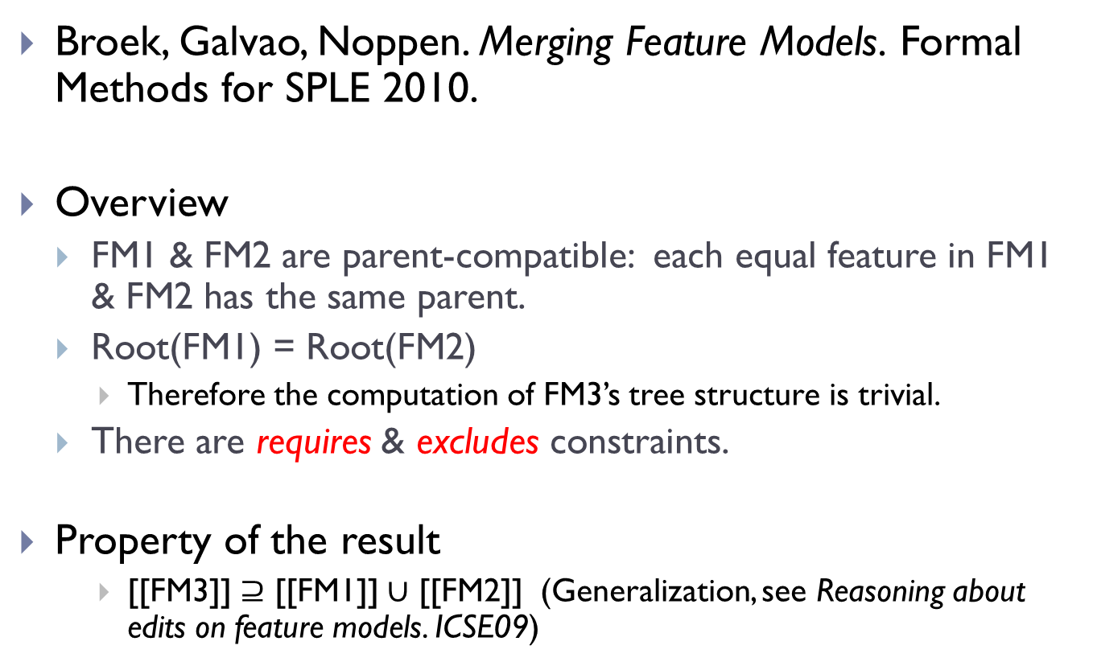
Approach #1
Broek, Galvao, Noppen. Merging Feature Models. Formal Methods for SPLE 2010.
Overview
FM1 & FM2 are parent-compatible: each equal feature in FM1 & FM2 has the same parent.
Root(FM1) = Root(FM2)
Therefore the computation of FM3’s tree structure is trivial.
There are requires & excludes constraints.
Property of the result
[[FM3]] $⊇$ [[FM1]] $∪$ [[FM2]] (Generalization, see Reasoning about edits on feature models. ICSE09)

Slide 4
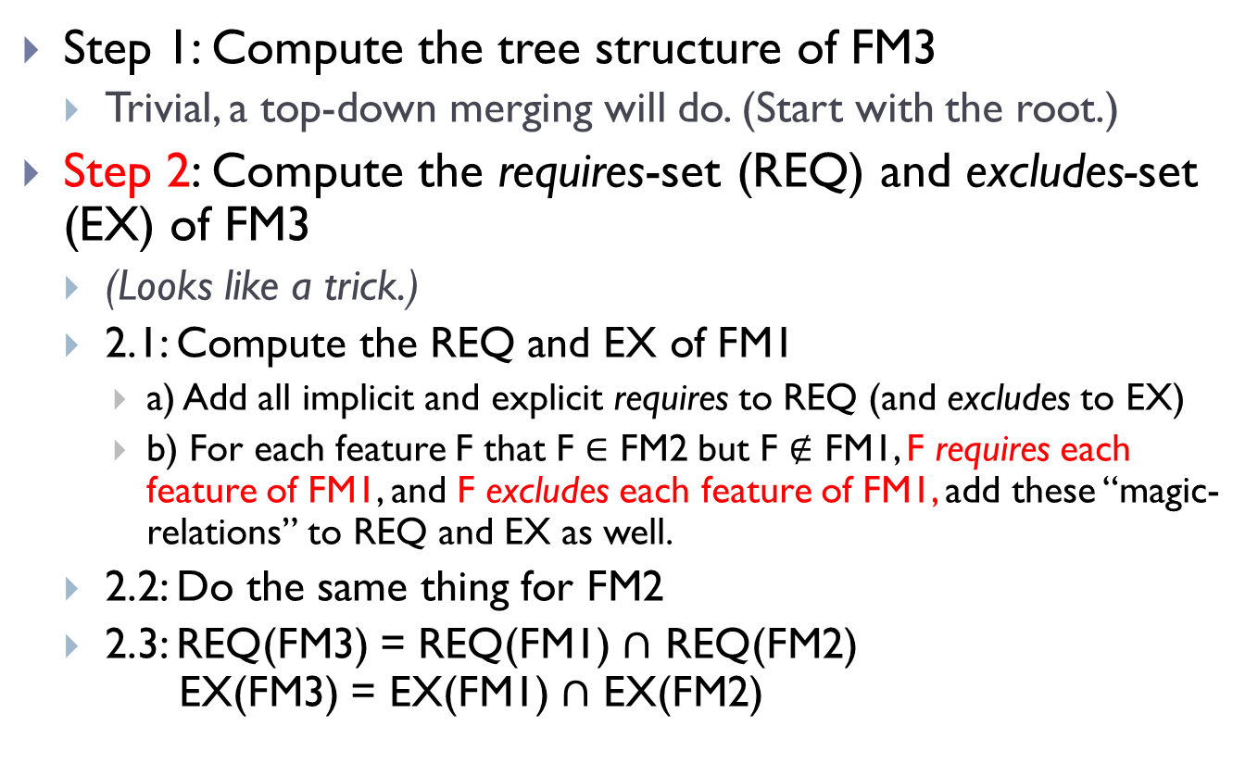
The merge algorithm
Step 1: Compute the tree structure of FM3
Trivial, a top-down merging will do. (Start with the root.)
Step 2: Compute the requires-set (REQ) and excludes-set (EX) of FM3
(Looks like a trick.)
2.1: Compute the REQ and EX of FM1
a) Add all implicit and explicit requires to REQ (and excludes to EX)
b) For each feature F that F $∈$ FM2 but F $∉$ FM1, F requires each feature of FM1, and F excludes each feature of FM1, add these “magic-relations” to REQ and EX as well.
2.2: Do the same thing for FM2
2.3: REQ(FM3) = REQ(FM1) $∩$ REQ(FM2) EX(FM3) = EX(FM1) $∩$ EX(FM2)
What’s this ??
What’s this ??

Slide 5

An example
[[FM3]] $⊇$ [[FM1]] $∪$ [[FM2]]
A
A
A
+
=
A
B
C
B
C
B
C
D
E
D
E
exclude
FM1
FM2
FM3
Mandatory
Optional

Slide 6
Example: compute REQ and EX
REQ(FM1) =
{ <A, B>, <B, A>, <A, C>, <C, A>, <B, D>, <D, B>,
<E, A>, <E, B>, <E, C>, <E, D> }
REQ(FM2) =
{ <A, B>, <B, A>, <A, C>, <C, A>, <C, E>, <E, C>,
<D, A>, <D, B>, <D, C>, <D, E> }
Implicit requires
Trick-requires

Slide 7
Example: compute REQ and EX
REQ(FM1) =
{ <A, B>, <B, A>, <A, C>, <C, A>, <B, D>, <D, B>,
<E, A>, <E, B>, <E, C>, <E, D> }
REQ(FM2) =
{ <A, B>, <B, A>, <A, C>, <C, A>, <C, E>, <E, C>,
<D, A>, <D, B>, <D, C>, <D, E> }
REQ(FM3) =
{ <A, B>, <B, A>, <A, C>, <C, A>, <D, B>, <E, C> }
A
B
D
A
C
E
B
C
Mandatory becomes optional.
D
E

Slide 8
Example: compute REQ and EX
EX(FM1) =
{ (E, A), (E, B), (E, C), (E, D) }
EX(FM2) =
{ (D, A), (D, B), (D, C), (D, E) }
EX(FM3) = { (D, E) }
Trick-excludes (no actual excludes in FM1 & FM2)

Slide 9
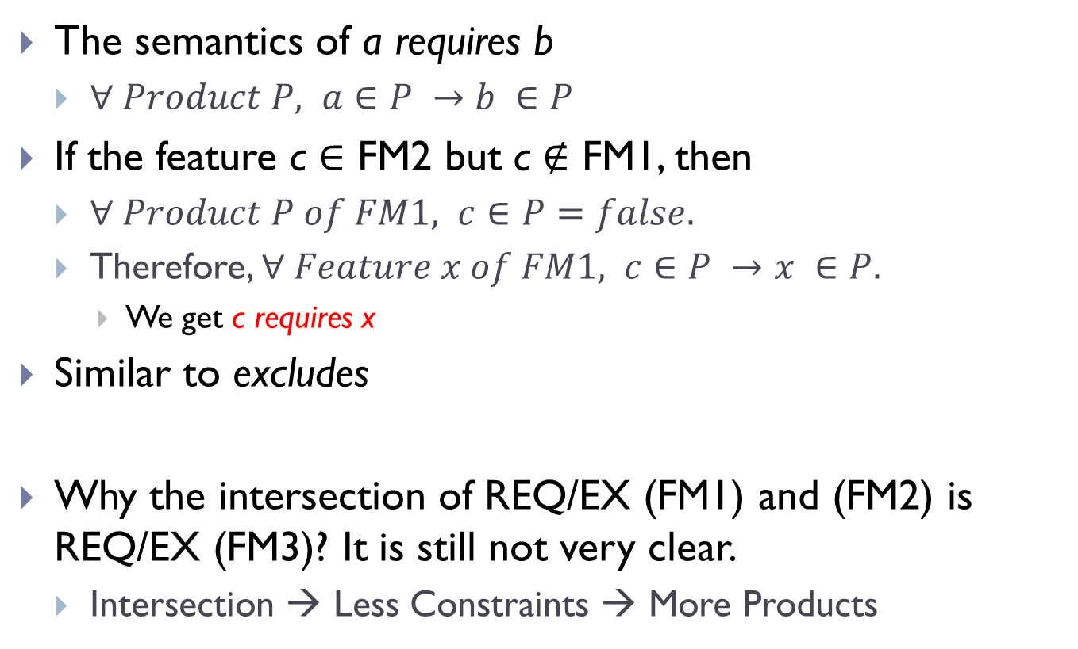
Reasoning the trick
The semantics of a requires b
$∀ Product P, a∈P →b ∈P$
If the feature c $∈$ FM2 but c $∉$ FM1, then
$∀ Product P of FM1, c∈P=false.$
Therefore, $∀ Feature x of FM1, c∈P →x ∈P.$
We get c requires x
Similar to excludes
Why the intersection of REQ/EX (FM1) and (FM2) is REQ/EX (FM3)? It is still not very clear.
Intersection → Less Constraints → More Products

Slide 10
Discussion
The need of parent-compatible is not hard to satisfy for real FMs (e.g. feature renaming or aligning before merging).
Define the semantics of a feature model by its product set.
Strengths
Handling explicit requires and excludes.
Easy to automation.
Weakness
The authors haven’t give enough reasoning about computing the REQ and EX, although it seems to work.

Slide 11
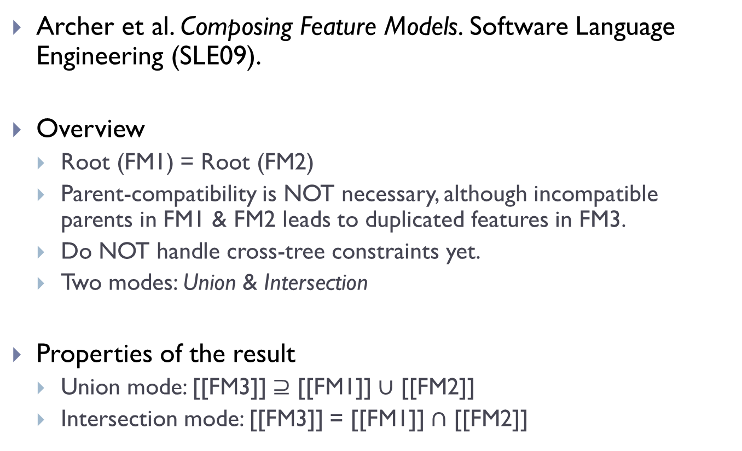
Approach #2
Archer et al. Composing Feature Models. Software Language Engineering (SLE09).
Overview
Root (FM1) = Root (FM2)
Parent-compatibility is NOT necessary, although incompatible parents in FM1 & FM2 leads to duplicated features in FM3.
Do NOT handle cross-tree constraints yet.
Two modes: Union & Intersection
Properties of the result
Union mode: [[FM3]] $⊇$ [[FM1]] $∪$ [[FM2]]
Intersection mode: [[FM3]] = [[FM1]] $∩$ [[FM2]]

Slide 12
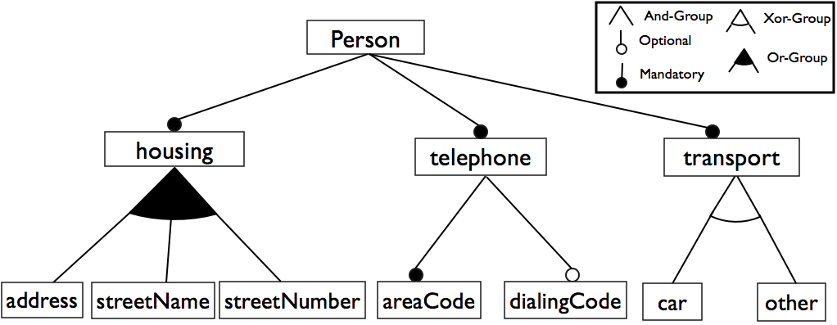
Notation of the feature models in this approach
Variability Operators
NOTES:
- Mandatory/Optional are specified explicitly for And-Groups.
- A single child feature is expressed by an And-Group with only one feature.

Slide 13
The merge algorithm
Start from the root.
Root3 (FM3) = Root2 (FM2) = Root1 (FM1).
1. Decide the variability operator of Root3.
2. For each common child of Root1 and Root2, merge the child, and add the merged child to Root3.
3. (For Union mode only.) Insert the unique children of Root1 and Root2 to Root3, respectively.
root3
root3
root3
common
common’
root3
common
unique2
common’
unique1

Slide 14
Deciding the merged variability operator
Union mode: [[FM3]] $⊇$ [[FM1]] $∪$ [[FM2]]
FM2 FM1 | And-Mandatory | And-Optional | Xor | Or
And-Man | And-Man | And-Opt | Or | Or
And-Opt | And-Opt | And-Opt | And-Opt | And-Opt
Xor | Or | And-Opt | Xor | Or
Or | Or | And-Opt | Or | Or

Slide 15
Deciding the merged variability operator
Intersection mode: [[FM3]] = [[FM1]] $∩$ [[FM2]]
FM2 FM1 | And-Mandatory | And-Optional | Xor | Or
And-Man | And-Man | And-Man | And-Man | And-Man
And-Opt | And-Man | And-Opt | Xor | Or
Xor | And-Man | Xor | Xor | Xor
Or | And-Man | Or | Xor | Or

Slide 16
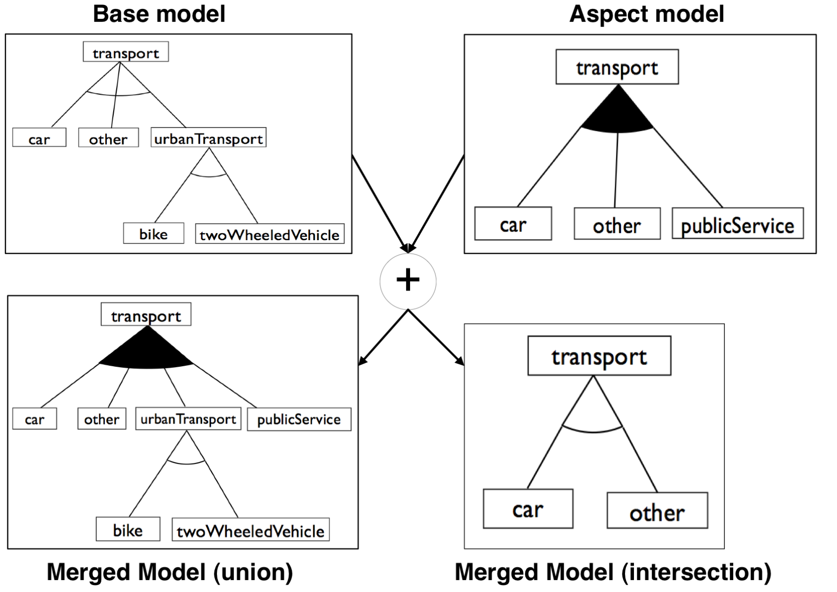
An example
FM1
FM2

Slide 17
An example of merging parent-incompatible FMs
A
A
+
B
C
D
B
F
D
E
E
A
=
B
C
F
D
E
E
Lead to duplicated features.

Slide 18
Discussion
Similar to approach #1, feature renaming/aligning before merging can resolve incompatible parents and non-matching features.
Also define the semantics of a feature model by its product set.
Approach #1 is actually union-mode merging.
Approach #1 can be integrated for computing explicit requires/excludes in the merged FM.
Approach #2 handles various refinements in a reasonable manner.

Slide 19
Approach #3
Schobbens et al. Generic semantics of feature diagrams. Computer Networks 2006.
Actually, this is a proof of computation complexity of union-merge and intersection-merge, not an algorithm.
The conclusion is that merge can be done in linear space and time.

Slide 20
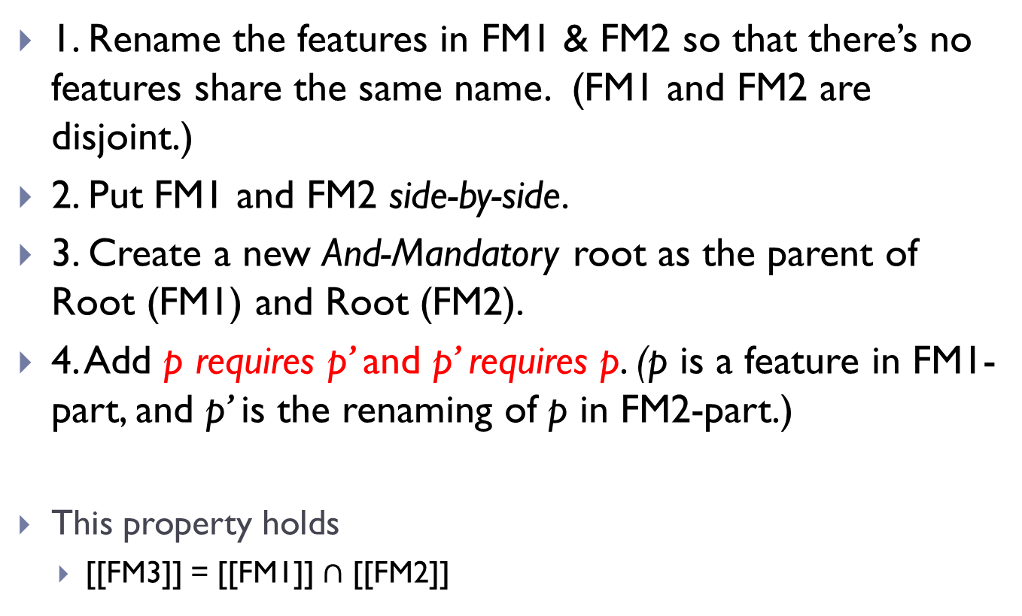
The intersection-merge
1. Rename the features in FM1 & FM2 so that there’s no features share the same name. (FM1 and FM2 are disjoint.)
2. Put FM1 and FM2 side-by-side.
3. Create a new And-Mandatory root as the parent of Root (FM1) and Root (FM2).
4. Add p requires p’ and p’ requires p. (p is a feature in FM1-part, and p’ is the renaming of p in FM2-part.)
This property holds
[[FM3]] = [[FM1]] $∩$ [[FM2]]

Slide 21
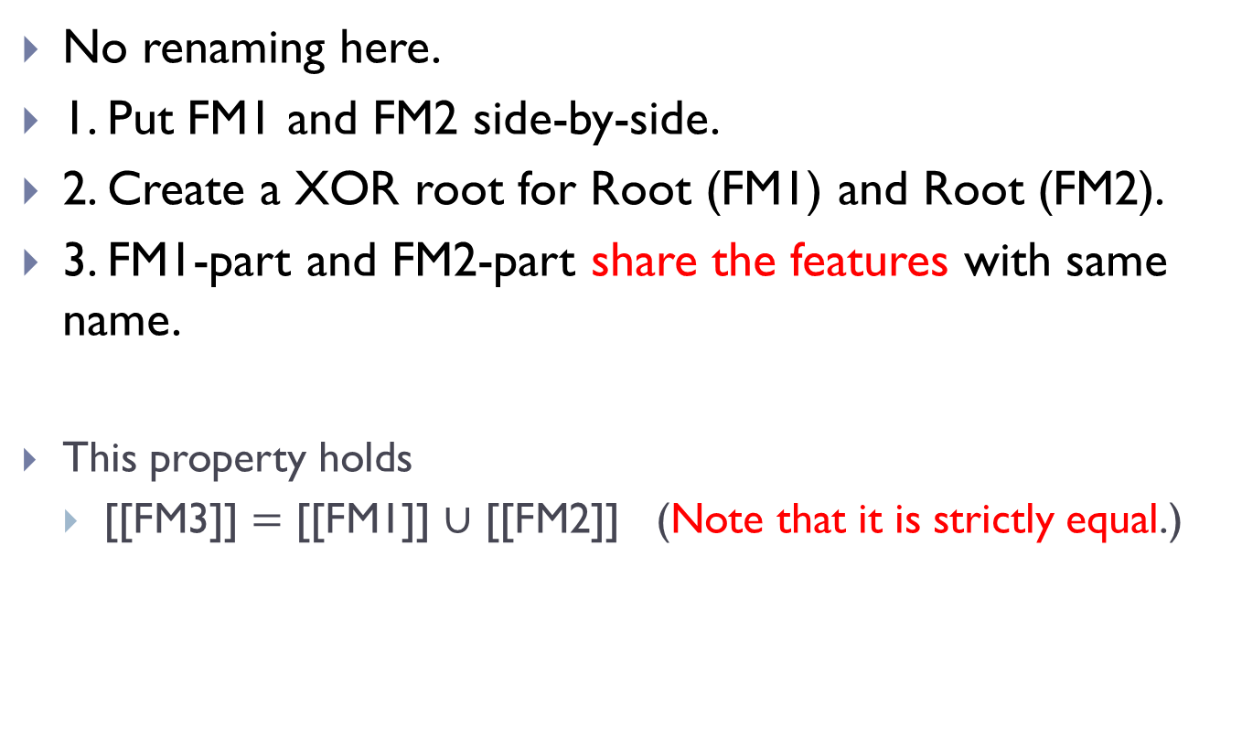
The union-merge
No renaming here.
1. Put FM1 and FM2 side-by-side.
2. Create a XOR root for Root (FM1) and Root (FM2).
3. FM1-part and FM2-part share the features with same name.
This property holds
[[FM3]] $=$ [[FM1]] $∪$ [[FM2]] (Note that it is strictly equal.)

Slide 22
Example of union-merge
A
+
G
B
C
D
B
F
D
R
=
XOR
A
G
C
B
F
D

Slide 23
Discussion
This approach (actually a proof) is quite straightforward.
Least time and space.
Easiest way to do the merging.
Preserve all explicit constraints.
Also define the semantics of FMs in terms of its product set.
Sharing features in union-merge is unaccepted in many feature models. (It’s the point that has been criticized by others.)
However, it is acceptable in our CoFM. We might consider it if the merging is not a key operation in our system.

